Slide 1
BLOCKCHAIN

Slide 2
Introduction about blockchain
A blockchain is a digital transaction of records that’s arranged in chunks of data called blocks.
These blocks link with one another through a cryptographic validation known as a hashing function.
Linked together, these blocks form an unbroken chain—a blockchain.
A blockchain is programmed to record not only financial transactions but virtually everything of value.
Another name for blockchain is distributed ledger.

Slide 3
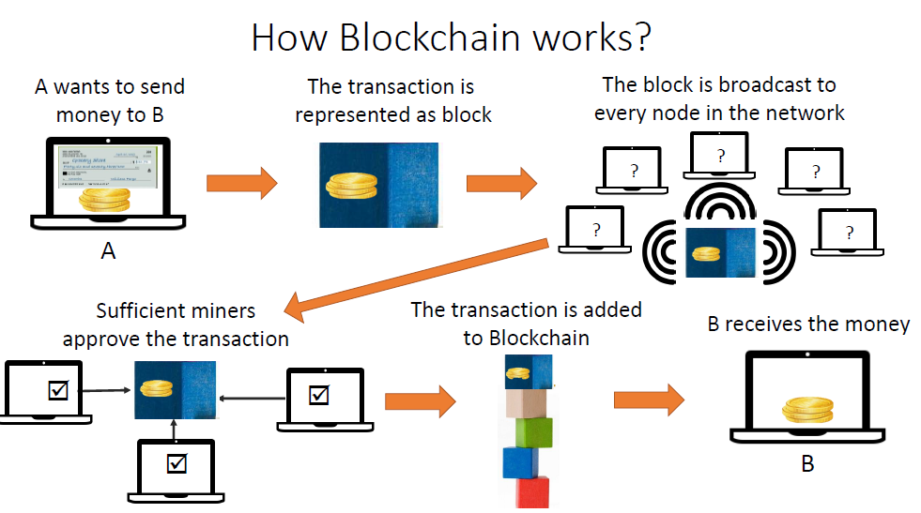

Slide 4
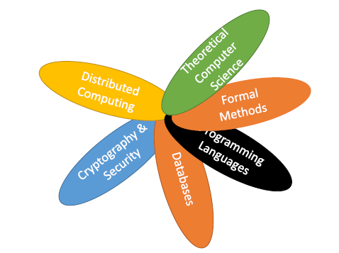
Blockchain is interdisciplinary

Slide 5
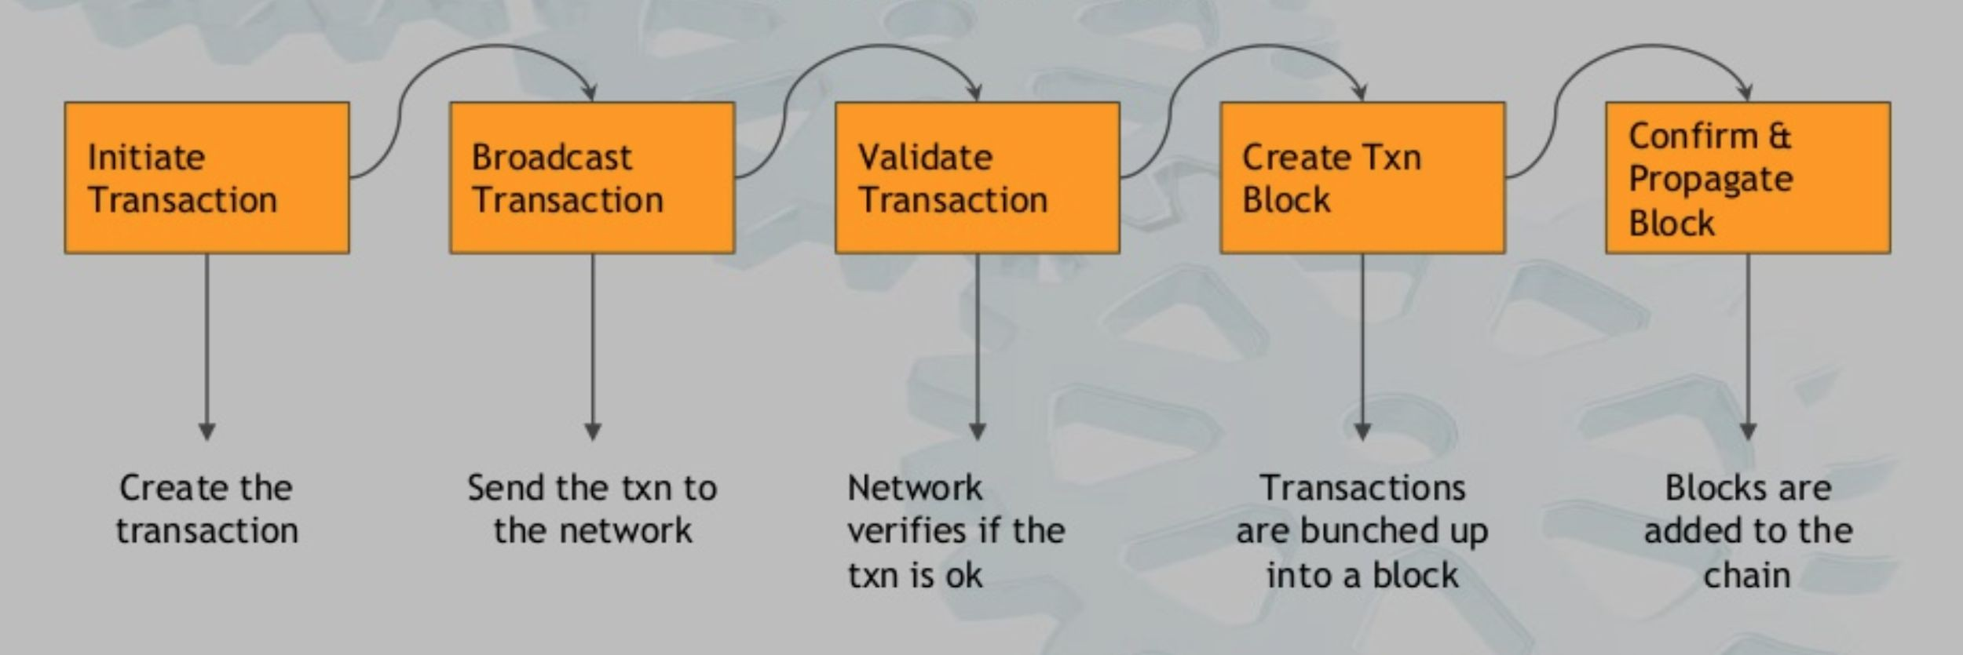
HOW DOES BLOCKCHAIN WORK

Slide 6
The blockchain network has no central authority —
  it is the very definition of a decentralized system.
  Since it is a shared and immutable ledger, the information in it is open for anyone and everyone to see.
  Hence, anything that is built on the blockchain is by its very nature transparent
  everyone involved is accountable for their actions.

Slide 7
Blockchain is a shared, immutable ledger that facilitates the process of recording transactions and tracking assets in a business network. An asset can be tangible (a house, car, cash, land) or intangible (intellectual property, patents, copyrights, branding).
Virtually anything of value can be tracked and traded on a blockchain network, reducing risk and cutting costs for all involved.

Slide 8
Why blockchain
#. Bring Trust : To establish trust between ourselves, we depend on individual third parties such as banks, land registries, government etc.
#. Decentralization: Chances of error, mistakes and corruption can happen in centralized control systems.
#. Remove Middle Man : They always comes with somewhat risk and cost.

Slide 9
BLOCKCHAIN
Blockchain is a completely new distributed infrastructure and computing paradigm formed by reorganizing mature technologies such as
  hash function,
  Merkle tree,
  Proof of work (PoW)
  combining cryptographic technologies such as public key encryption, digital signature and
  .

Slide 10

The history of Bitcoin
2008
Idea was published under the pseudonym Satoshi Nakamoto
2009
Start of the Bitcoin NetworkZ
2010
Fist cryptocurrency stock exchange is launched
2011
One Bitcoin equals one USD
2013
1 Bitcoin equals
100 USDV
2014
Microsoft accepts Bitcoin
2017
1 Bitcoin equals
10,000 USD
Notes:
History of Blockchain
Although blockchain is a new technology, it already boasts a rich and interesting history. The following is a brief timeline of some of the most important and notable events in the development of blockchain.
2008
Satoshi Nakamoto, a pseudonym for a person or group, publishes “Bitcoin: A Peer to Peer Electronic Cash System."
2009
The first successful Bitcoin (BTC) transaction occurs between computer scientist Hal Finney and the mysterious Satoshi Nakamoto.
2010
Florida-based programmer Laszlo Hanycez completes the first ever purchase using Bitcoin — two Papa John’s pizzas. Hanycez transferred 10,000 BTC’s, worth about $60 at the time. Today it's worth $80 million.
The market cap of Bitcoin officially exceeds $1 million.
2011
1 BTC = $1USD, giving the cryptocurrency parity with the US dollar.
Electronic Frontier Foundation, Wikileaks and other organizations start accepting Bitcoin as donations.
2012
Blockchain and cryptocurrency are mentioned in popular television shows like The Good Wife, injecting blockchain into pop culture.
Bitcoin Magazine launched by early Bitcoin developer Vitalik Buterin.
2013
BTC market cap surpassed $1 billion.
Bitcoin reached $100/BTC for first time.
Buterin publishes “Ethereum Project" paper suggesting that blockchain has other possibilities besides Bitcoin (e.g., smart contracts).
2014
Gaming company Zynga, The D Las Vegas Hotel and Overstock.com all start accepting Bitcoin as payment.
Buterin’s Ethereum Project is crowdfunded via an Initial Coin Offering (ICO) raising over $18 million in BTC and opening up new avenues for blockchain.
R3, a group of over 200 blockchain firms, is formed to discover new ways blockchain can be implemented in technology.
PayPal announces Bitcoin integration.
2015
Number of merchants accepting BTC exceeds 100,000.
NASDAQ and San-Francisco blockchain company Chain team up to test the technology for trading shares in private companies.
2016
Tech giant IBM announces a blockchain strategy for cloud-based business solutions.
Government of Japan recognizes the legitimacy of blockchain and cryptocurrencies.
2017
Bitcoin reaches $1,000/BTC for first time.
Cryptocurrency market cap reaches $150 billion.
JP Morgan CEO Jamie Dimon says he believes in blockchain as a future technology, giving the ledger system a vote-of-confidence from Wall Street.
Bitcoin reaches its all-time high at $19,783.21/BTC.
Dubai announces its government will be blockchain-powered by 2020.
2018
Facebook commits to starting a blockchain group and also hints at the possibility of creating its own cryptocurrency.
IBM develops a blockchain-based banking platform with large banks like Citi and Barclays signing on.

Slide 11
Classification- According to different application scenarios and network admission mechanism
Blockchain technology can be divided into
  public chain,
  alliance chain
  private chain.

Slide 12
PUBLIC CHAIN
In the public blockchain,
  data can be easily accessed, which provides an unprecedented opportunity for data analysts to analyze various behaviors in the system by using transaction data, ie we are having permission to read, write and participate within the blockchain.
  The public chain is usually also called Permissionless Blockchain.
  Anyone can participate in the maintenance and accessing to the data on the blockchain,
  easy to deploy applications, and completely decentralized without being controlled by any institution.
Bitcoin, Ethereum etc., have no restrictions on the joining and exiting of nodes, are typical public chains.
At present, various public chains such as Bitcoin, Ethereum etc., have obtained a large number of users and accumulated a large amount of transaction data.

Slide 13
PUBLIC CHAIN
The public chain is a fully decentralized blockchain.
It uses cryptography to ensure that transactions cannot be tampered with.

Slide 14
PRIVATE CHAIN
Is a permissioned blockchain.
Private chains, which are limited to enterprises, state agencies or individuals, cannot completely solve the trust problem, but can improve auditability.
It is often used for internal database management, auditing, government budget and execution, or government industry statistics, etc.
They need to be transparent to each other, but not to the public.
The value of the private chain is mainly to provide a secure, traceable, non-tamperable, automatic execution computing platform, which can prevent both internal and external security attacks on data, which is difficult to achieve in traditional systems.

Slide 15
Public Blockchain : No access restriction every participant would able to read and write.
● Private Blockchain : It is permissioned based in which network administrators (owner) invite to selected member, It is read by all but only owner has the right to making any changes in rules or other terms.
● Consortium /Alliance Blockchain : It is semi-decentralized system in which number of organization controlling to it. Control of write, read and verify provided to group of organization.

Slide 16
Alliance chain
is a kind of blockchain that requires registration permission.
This kind of blockchain is also called Permissioned Blockchain.
The alliance chain is limited to the participation of alliance members, and the scale of the alliance can be as large as between countries, or between different institutions and enterprises.
The number of nodes is much smaller compared to public blockchain, such as bitcoin blockchain, since the nodes can join the network only when they are trusted.

Slide 17
2. Blockchain architecture
BLOCKCHAIN ARCHITECTURE
Blockchain is the underlying technology of Bitcoin.
In 2008, a scholar named “Satoshi Nakamoto” proposed a digital currency called Bitcoin.
In the absence of any authoritative intermediaries, people who do not trust can pay directly in Bitcoin.
In October 2016, China Blockchain Technology and Application Development White Paper published by the Ministry of Industry and Information Technology described Blockchain Technology as a new application mode of computer technology, such as distributed data storage, point-to-point transmission, and consensus mechanism and encryption algorithm.

Slide 18
Bitcoin ≠ blockchain
Is the underlying datastructure, which can be used for many things, including cryptocurrencies
Is an application of blockchain technology

Slide 19
Technical architecture of the blockchain
. Proposed a five-layer framework:-----PROPOSED BY MEMBERS YANG
  data layer,
  network layer,
  consensus layer,
  incentive layer,
  contract layer and
  application layer.
Another proposal from the perspective of privacy protection: three-tier framework
  network layer,
  transaction layer and
  application layer.
From the perspective of facilitating data analysis, this paper proposed a three-tier framework:
  application layer,
  contract layer,
  transaction layer.

Slide 20
3 tier architecture

Slide 21
Layers in blockchain
The three-tier framework not only represents three types of block chain data, but also represents three stages of block chain development.
Bottom layer---transaction layer,
Block chain development stage --- Block chain development stage 1.0,
i.e programmable currency, represented by Bitcoin.
Transaction means not only ---to change blockchain data, Transaction is an important basic data in blockchain.
Major task of blockchain 1.0--- Recording transactions to ensure the global uniqueness and irreversible modification of blockchain data.

Slide 22
Middle layer
The middle layer is the contract layer,
Block chain development stage --- Block chain development stage .2.0,
i.e programmable finance, Ethereum is representative.
Smart contract was proposed by Szabo in 1994, a digital protocol that uses algorithms and procedures to compile contract terms, deploys on blockchain, and can be automatically executed according to rules.
The smart contract itself is also an important data type for Blockchain 2.0, which we call contract data.
The deployment and operation of smart contracts is not only inseparable from transactions, but also generates new transaction data.

Slide 23
Top Layer
The top layer is the application layer,
Block chain development stage --- Block chain development stage .3.0,
i.e programmable society, such as decentralized application, decentralized autonomous organization.
The application layer can be built on top of the contract layer to implement many complex automation functions, or directly on the transaction layer (thus the contract layer is represented by dotted lines).
At present, because the blockchain technology is still in the early stage of development, there is a lack of application data combined with actual scenarios.

Slide 24
The operating environment of the blockchain is distributed, and its three-tier framework is in a distributed environment.
  For example, the same smart contract is stored as a type of data on every node in a distributed environment.
  When a transaction triggering contract operation is received, each node runs the relevant contract based on the local blockchain data and stores the running results in the local data.
  Finally, through the consensus mechanism, the local data is consistent with the entire distributed network.
In a distributed network environment of blockchain, there are usually a large number of nodes.

Slide 25
3. Blockchain data structure and data type
In order to achieve data tampering, the blockchain is constructed into a chain structure in units of blocks.
The data structures on different blockchain platforms are slightly different, but basically the same.
Each block is identifiable by a hash, generated using the SHA 256 cryptographic hash algorithm on the header of the block.
Each block references a previous block, also known as the parent block, in the “previous block hash” field, in the block header

Slide 26
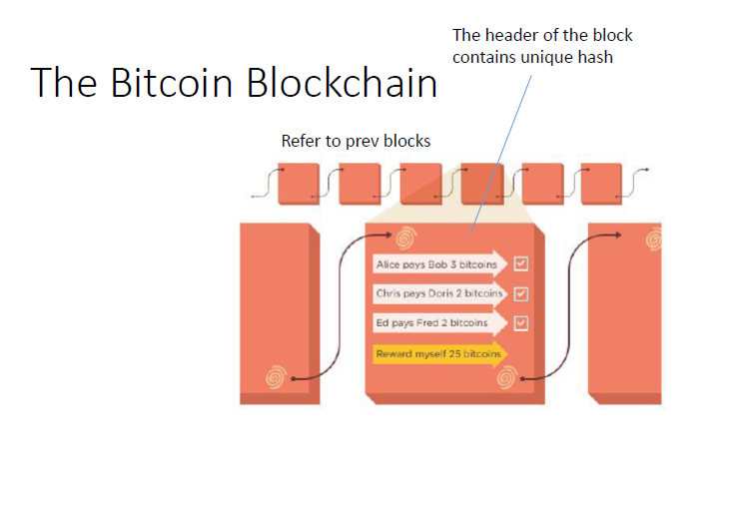

Slide 27
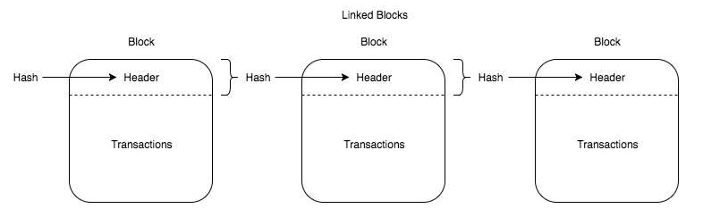

Slide 28
Blockchain data structure
Taking Bitcoin as an example, each block is composed of a
block header
  block header stores a pre-block hash (PrevBlockHase) , random number (Nonce), Merkle root (MerkleRoot), PoW etc
block body,
  and block body stores multiple transactions that occurred after the previous block;.
  The blockchain guarantees irreversible modification of data based on two hash structures, Merkle tree and block list.

Slide 29
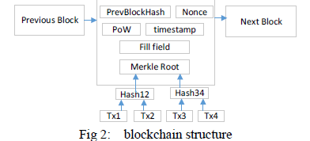

Slide 31
The Merkle tree
First proposed by Ralph Merkle and was originally used to generate summaries of digital certificate directories.
Bitcoin uses the simplest binary Merkle tree.
The list of transactions is stored as a Merkle tree. A Merkle tree is a tree data structure in which every leaf node is the hash of a transaction and every non-leaf node is the cryptographic hash of the child nodes
Each node in the tree is a hash value, and stores a SHA256 hash value of a transaction data.
The values of two leaf nodes are spliced/joined together, and then the values of the parent node are obtained by hashing operation.
Repeatedly calculate the hash value of the parent node until the root is generated, that is, transaction merkle root.
With the Merkle root, tampering of any transaction data in the block is detected, ensuring the integrity of the transaction data.

Slide 32
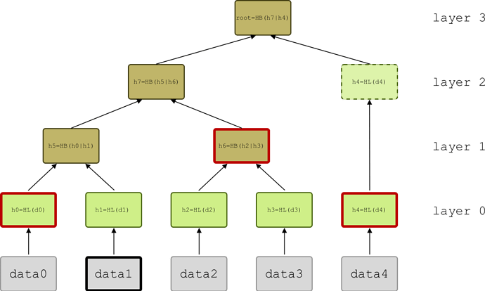

Slide 33
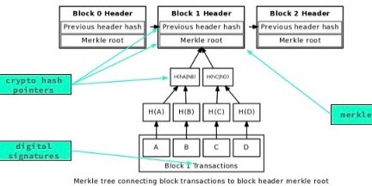

Slide 34
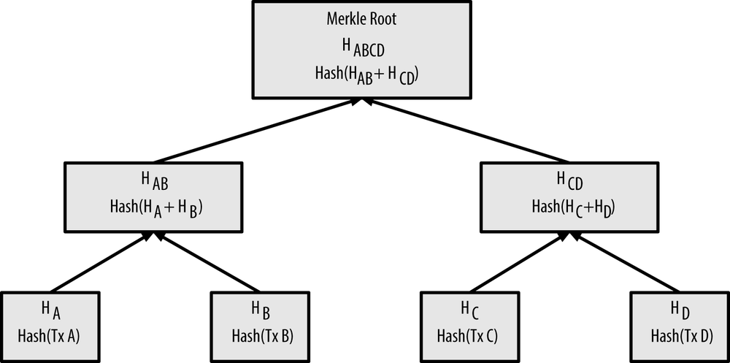

Slide 35
Block list
The hash value of the block header is obtained by performing a SHA256 hash operation on the metadata such as the Prev-BlockHash, the Nonce, and the Merkle root in the block header.
PrevBlockHash stores hash value of the previous block.
All blocks are linked together in the order of generation with PrevBlockHash as a hash pointer, forming a block list.

Slide 36
The block header contains the transaction Merkle root, so you can verify whether the block header and transaction data have been tampered with by Hash operation.
The block header also contains the previous block hash value PrevBlockHash, so it is also possible to verify whether all blocks from the previous block of the block to the creation block have been tampered with by block hashing.
Relying on the PrevBlockHash, all blocks are interlocked, and any block is tampered with, causing a chain change of all the block hash pointers.
When a block and all previous blocks are downloaded from an untrusted node, block hashing can be used to verify whether each block has been modified.

Slide 37
Data type
Transaction data model.
  A transaction in the blockchain is usually a transfer, and Figure shows the data structure of the transaction in Bitcoin.
Each transaction includes multiple transaction inputs and multiple transaction outputs, indicating that one transaction can merge the bitcoins in the previous plurality of accounts and transfer them to another plurality of accounts.

Slide 38
TRANSACTION INPUT
Each transaction input is mainly composed OF
  the hash value of the last transaction (PrevTxHash),
  the output index (Index) and
  the input script (ScriptSig).
The input of a transaction
  corresponds to the output of the previous transaction,
  PrevTxHash saves the hash of the previous transaction output
Index
  indicates that this transaction input corresponds to which transaction output in the transaction history.
The script (ScriptSig)
  contains the signature of the Bitcoin holder on the current transaction

Slide 39
TRANSACTION OUTPUT
Each transaction output
  includes the transfer amount (Value)
  script script-PubKey containing the recipient's public key hash (script-PubKey).

Slide 40
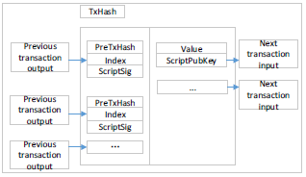
Data structure for bitcoin transaction

Slide 41
In the transaction-based model, all transactions depend on the hash pointer of the previous transaction to form a list of transactions as nodes.
Each transaction can be traced back to the first transaction in the trading chain Coinbase (ie bitcoin from mining).
Transaction-based model can effectively prevent counterfeiting, double-flower attacks against digital currency.

Slide 42
(2) Account-based model.
The transaction-based model makes it easy to verify transactions, but it cannot quickly query user balances.
To support more types of industry applications, blockchain platforms such as Ethereum and Hyperledger Fabric use an account-based model to easily query the transaction balances or trading status data.
Smart contracts are also better suited to build on an account-based model that is easier to handle complex business logic for state data.
The accounts under Ethereum are divided into two types:
  External account (Externally Owned Account) and
  Contract account (Contract Account).
The external account is used to record the Ethereum balance,
the contract account is used to store the smart contract.

Slide 43
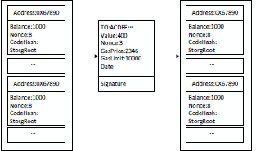
When a transaction occurs, it will trigger a change in account status.[figure]
External accounts and contract accounts are represented by the same data structure in Ethereum, which contains four attributes:
  Balance,
  Nonce,
  CodeHash and
  StorageRoot.

Slide 44
Balance records the Ethereum balance of the account.
Nonce counts the number of transactions initiated by the account to prevent replay attacks.
CodeHash is the hash value of the contract code when the account is applied to a smart contract.
StorageRoot is the MerklePatricia root of contract status data

Slide 45
Ethereum's transactions include seven attributes:
  To - saves the recipient's account address
  Value -Value is the amount of ethernic currency transferred.
  Nonce-Nonce counts the number of transactions initiated by the transaction
  gasPrice- GasPrice is the unit price of the Ether of Gas at the time of the transaction
  gasLimit- gasLimit is the maximum amount of Gas allowed to execute this transaction
  Data - Data is the message data when the smart contract is invoked
  transaction signature.-is the initiator's ECDSA signature of the transaction.
    Elliptic Curve Digital Signature Algorithm (ECDSA) offers a variant of the Digital Signature Algorithm (DSA) which uses elliptic curve cryptography.
  On the ethereum blockchain, gas refers to the cost necessary to perform a transaction on the network.
  Miners set the price of gas and can decline to process a transaction if it does not meet their price threshold.

Slide 46
Contract data
Introduced in the year 1995,
cryptographer Szabo first proposed the concept of smart contract.
He pointed out that "smart contracts stimulate contract execution by using protocols and user interfaces".

Slide 47
Smart contract is
  a commercial contract; self-executing contracts containing the terms and conditions of an agreement among peers.
  The terms and conditions of the agreement are written into code.
  written in a programming language that automatically enforces the terms of the contract when the predetermined conditions are met,
  Thus ,achieving the goal of "code is the law."

Slide 48
The existing smart contract works like the If-Then statement of other computer programs.
The smart contract executes on the Ethereum blockchain's decentralized platform.
The agreements facilitate the exchange of money, shares, property, or any asset.
Because blockchain data has important features such as non-tampering and complete credibility, building smart contracts based on blockchain data has natural advantages.
There are two widely-used programming languages for writing Ethereum smart contracts – Solidity and Serpent

Slide 49
The life cycle of smart contract includes three stages:
  contract generation,
  contract publication and
  contract execution.

Slide 50
Contract generation mainly includes four aspects:
  multi-party negotiation,
  contract specification,
  contract verification, and
  contract code.
The specific implementation process is as follows:
  The contract participants negotiate with each other;
  the parties clarify their respective rights and obligations,
  jointly determine the contract text,
  write the program, test the program, and finally obtain the standard contract code.

Slide 51
Contract release is similar to transaction release.
Steps for contract release
  The signed contract is distributed to each node through P2P, and each node will temporarily store the received contract in memory and wait for consensus.
  Each node will package the new temporary contract into a contract set,
  calculate the hash value of the set,
  Assemble the hash value of the contract set into a block and spread to other nodes of the whole network.
  The node that receives the block will compare the Hash value stored in the block with the Hash value of the contract set saved by itself.
  Through multiple rounds of transmission and comparison, all nodes will eventually reach a consensus on the newly issued contracts, and the agreed contracts will be distributed to all nodes in the network in block form.

Slide 52
Smart contract structure
Each of the blocks contains the following information:
  Root Hash of the Current Block,
  Root Hash of the Previous Block,
  TimeStamp,
  contract data, and
  other descriptive information.

Slide 53
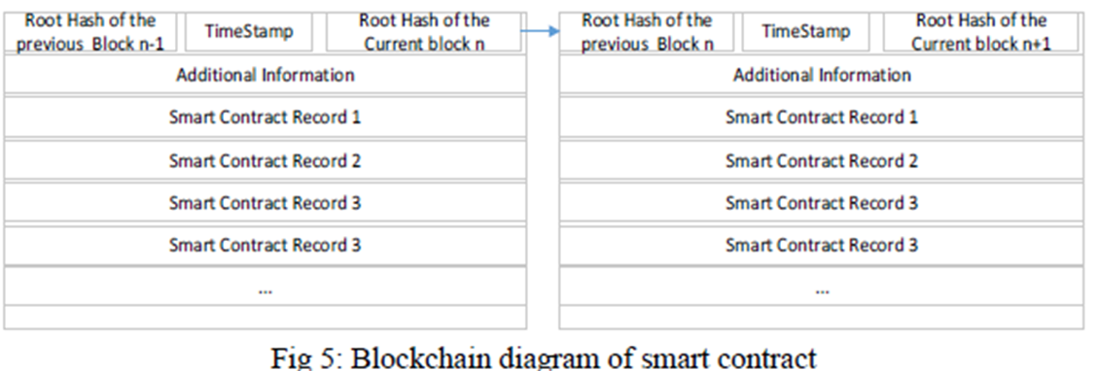

Slide 54
The execution of smart contracts is based on the "event-triggered" mechanism.
The smart contract on the blockchain contains transaction processing and saving mechanisms and a complete state machine for accepting and processing various smart contracts.
The smart contract periodically traverses the state machine and trigger conditions of each contract, pushing the contract that meets the trigger condition to the queue to be verified.
The contract to be verified will spread to each node, just like a normal transaction.
The node will first verify the signature to ensure the legitimacy of the contract.
The validated contract will be successfully executed after reaching a consensus.
Finally, all nodes will reach a consensus on the contract.

Slide 55
The processing of the entire contract is automatically completed by the smart contract system built into the bottom of the blockchain, which is open and transparent and cannot be tampered with.
Smart contract system can actively or passively accept, store, process and send data, and call smart contract, so as to control and manage digital objects in the chain.
The smart contract technology platforms that have emerged, such as Ethereum and Hyperledger, have Turing's complete development scripting language, enabling the blockchain to support smarter contract applications for financial and social systems

Slide 56
Problems to be solved in blockchain data analysis
Based on relevant literature analysis, the focus of blockchain data analysis can be summarized into seven aspects:
entity identification,
privacy risk analysis
network portrait,
network visualization,
transaction pattern recognition,
market effect analysis,
illegal behaviour detection and analysis

Slide 57
Figure shows the relationship between these seven questions.
Solid arrows indicate that the previous study supports the next one, or that the previous study is the basis for the next one.
The dotted arrow indicates that the latter study is a specialization of the previous study from a certain perspective.
Two-way arrows indicate different aspects of the same problem.

Slide 58
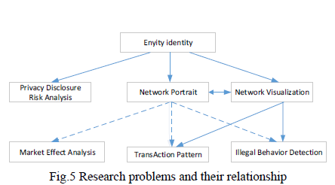

Slide 59
(1) Entity identification
In Bit coin transactions, users are anonymous.
transaction involves multiple users, and one user may participate in multiple transactions at the same time.
A natural question is: can you identify users from transaction records, or which addresses belong to the same user?
Since it is not possible to confirm that a user is identified, it is generally considered in the literature that an entity is identified.
An entity may be a user or an organization, and a user or an organization may also control multiple entities at the same time.

Slide 60
Heuristic methods are often used to identify potential entities, which can be divided into two main types:
  common input method --that all input addresses belong to the same entity in a transaction.
  change address method. ---the change address represents an entity.
    The change address definition is a plurality of output addresses of a transaction,

Slide 61
(2) Privacy protection.
Blockchain privacy protection can be divided into
  identity privacy protection
  transaction privacy protection.
Identity privacy protection requires that user's identity information, physical address, IP address are not related to user's public key, address and other public information on the blockchain.
Any unauthorized node can neither obtain any information about the user's identity by relying on the data disclosed in the blockchain, nor can it track and analyse user transactions and identity information through measures such as network monitoring and traffic analysis.

Slide 62
Transaction privacy protection requires that the data information of the transaction itself be anonymous to the unauthorized node.
The transaction information in Bitcoin refers to the transaction amount, the sender's public key of the transaction, the address of the recipient, and the purchase content of the transaction.
Any unauthorized node cannot obtain transaction-related knowledge through effective technical means.
In some blockchain that require high privacy protection, it is also required to separate the relationship between transactions and transactions, that is, the unauthorized nodes cannot effectively infer whether the two transactions have continuity, whether they belong to the same user or the like.

Slide 63
(3) Network portrait
In the face of massive transaction data, researchers hope to analyse
  How many users are involved in the transaction?
  What are the characteristics of these users?
  Does this huge payment network have the characteristics of a general complex network?
  Bitcoin as an "asset", how is it distributed among users?
  Do you meet the general laws of economics, etc.?
  And from the point of view of complex network, the characteristics of Bitcoin network are analysed.

Slide 64
(4) Network visualization
With the prevalence of blockchain technology, the transaction data stored in the blockchain increases rapidly.
Therefore, in the face of a large and rapidly growing trading network, it is an important research direction to study its visualization tools.
For example,
  the bitcoin trading network's visualization system, BitConeView, can be used to track bitcoin transactions in real time and intuitively.
  Especially, the system defines the concept of "purity" so as to find out the mixed currency transactions conveniently and monitor the potential money laundering banks in the Bitcoin network in real time.

Slide 65
5. Market Effect Analysis
The prices of encrypted currencies such as Bitcoin are highly volatile.
From the perspective of finance. this extremely high volatility has attracted economists to discuss whether bitcoin is a currency or not
On the other hand, from the perspective of data analysis, researchers hope to explain the driving factors behind this extreme volatility.
It is generally believed that the influencing factors include:
  miner behaviour;
  cryptographic currency system settings;
  user participation;
  policy;
  number of potential users and market sentiment;
  competition or alternative relationship with other cryptocurrencies and traditional assets.

Slide 66
(6) Illegal behaviour detection.
Unlike traditional bank payment systems, Bitcoin is an anonymous, non-centralized payment system.
Anonymous features lead to many illegal activities in bitcoin transactions, such as money laundering, fraudulent gambling, and the sale of contraband.
These illegal acts of exposure are only a small part, and a large number of illegal acts are not known.
Measures to Identify illegal behaviours based on transaction patterns and blockchain data analysis techniques helps to promote the healthy development of blockchain technology and can also provide reference for the supervision and legislation of the blockchain industry

Slide 67
(7) Transaction pattern recognition
Unlike traditional payment systems such as Banks, bitcoin is an anonymous, decentralized payment system.
An important question is the human payment behaviour in the context of anonymity
It is a valuable question whether specific patterns can be identified from blockchain transaction records to detect related illicit activity.

Slide 68
Types of blockchain network
#. Public + Permissionless Blockchains. Ex: Bitcoin, Ethereum, Litecoin
#. Private + Permissioned Blockchains. Ex: Multichain, Monax #. Consortium Blockchains . Ex: R3, EWF, Corda

Slide 69
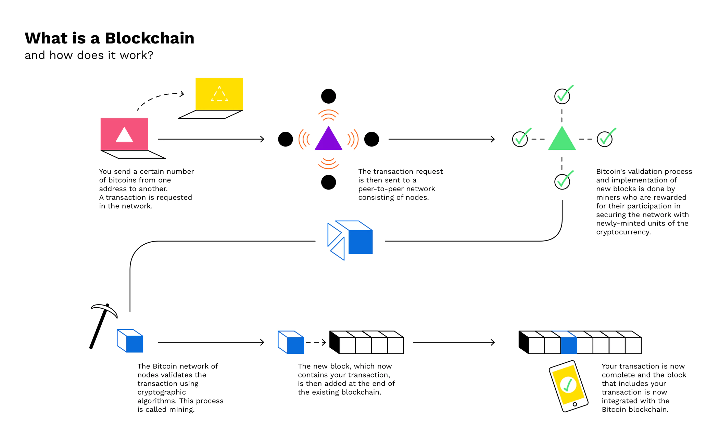

Slide 70
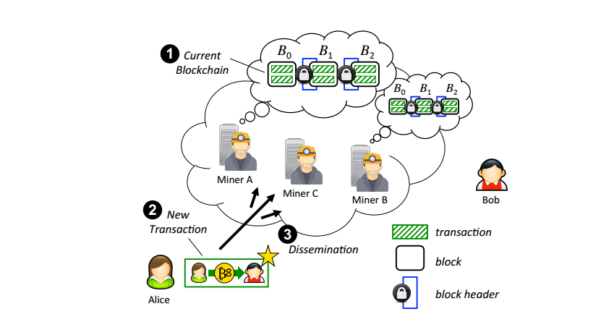

Slide 71
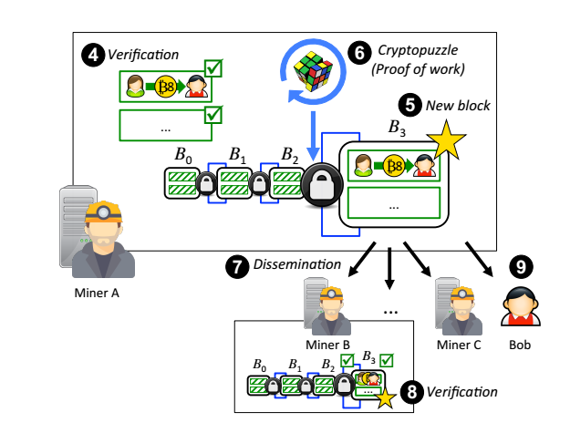

Slide 72
Use case
#. Voting & Governance
#. Supply Chain management.
#. Subsidy distribution/ Crowdfunding.
#. Real time money transfer.
#. Audit Logs
#. Sharing Economy.

Slide 73
Important questions
What is meant by Block Chaining?
With neat diagram explain blockchain data structure
What are the types of blockchain based on the classification according to different application scenarios and network admission mechanism
  Hint- Public, Private and Alliance
What is Contract Data ?
  Hint- definition of smart contract. Elaborate according to marks
Explain the Data models in Blockchain
  Hint- transaction data model and account based data model. Explain with diagram
Explain with block diagram the Smart contract structure
Explain the Blockchain architecture in detail.
  Hint- 3 layer- application,contract, transaction
Explain the problems to be solved in Blockchain Data Analysis.

Slide 74
https://www.youtube.com/watch?v=_160oMzblY8 https://www.youtube.com/watch?v=93E_GzvpMA0 https://anders.com/blockchain
https://www.slideshare.net/feronera/blockchain-introduction-80908060
https://blockgeeks.com/guides/what-is-hashing/ https://www.quandl.com/data/BCHAIN/NTRBL-Bitcoin-Number-of-Transaction-per-Block
https://blockgeeks.com/guides/what-is-blockchain-technology/
https://www.codemag.com/Article/1805061/Understanding-Blockchain-A-Beginners-Guide-to-Ethereum-Smart-Contract-Programming
https://www.movable-type.co.uk/scripts/sha256.html[FOR SHA256 ]

Slide 75
https://www.primafelicitas.com/blockchain-data-structure /

Slide 76
https://academy.horizen.io/technology/expert/blockchain-as-a-data-structure/

Slide 77
https://www.edureka.co/blog/blockchain-tutorial/
https://www.youtube.com/watch?v=WeuJqKEfSxM
https://medium.com/@sukantkhurana/a-very-basic-introduction-to-blockchain-in-cryptocurrencies-974be2914d96
https://blockgeeks.com/guides/what-is-blockchain-technology

